Slide 1
Straight Lines
Objectives:
D Grade Solve problems involving graphs, such as finding
where the line y = x +3 crosses the line y = 2
C Grade Find the mid-point of a line segment, given two
pairs of coordinates on the line
Prior knowledge: Recognise and draw straight lines from
equations of the form y = mx + c

Slide 2
24
7
30
Date
Finding the Midpoint of a Line
EQ – How do I find the midpoint of a line?

Slide 3
Straight Lines
To find the mid-point of a line segment we need to think about
where is half way:
x
½x
x
½y
x
y
mid-point
x
If we define the horizontal distance between the points as x
then half the horizontal distance between the points must be ½x
If we define the vertical distance between the points as y
then half the vertical distance between the points must be ½y

Slide 4
Straight Lines
To find the mid-point of a line segment as defined by coordinates
at either end we use the same principles
y
Find the mid-point of the
line segment from
(-3,2) to (3,6)
10
9
8
7
x
6
The distance in the
x-direction is the
difference between the
x-coordinates
5
4
x
3
2
1
x
3 - ⁻3 = 6
-10
-9
-8
-7
-6
-5
-4
-3
-2
-1
0
1
2
3
4
5
6
7
8
9
10
-1
The distance in the
y-direction is the
difference between the
y-coordinates
-2
-3
-4
-5
-6
-7
6 - 2 = 4
-8
-9
-10

Slide 5
Straight Lines
To find the mid-point of a line segment as defined by coordinates
at either end we use the same principles
y
Find the mid-point of the
line segment from
(⁻3,2) to (3,6)
10
9
8
7
x
6
x distance = 6
5
x
y distance = 4
4
x
3
½x distance = 3
2
½ y distance = 2
1
x
-10
-9
-8
-7
-6
-5
-4
-3
-2
-1
0
1
2
3
4
5
6
7
8
9
10
co-ordinates (0,4)
-1
-2
This can be calculated by
the first coordinates
+ half the difference
-3
-4
-5
-6
(⁻3+3,2+2) = (0,4)
-7
-8
-9
-10

Slide 6
Straight Lines
There is another, quicker way of finding the mid-point,
understanding that the mid-point will be half way between the
two sets of x co-ordinates and the two sets of y co-ordinates
For a pair of coordinates (x₁,y₁) and (x₂,y₂)
The point half way between them can be calculated as:
(
x₂+ x_{1,} y₂+ y₁
2 2
)
Find the mid point of the line segment between (-4,3) and (1,2)
(
1 + ⁻4, 3 + 2
2 2
)
=(⁻ 1½,2½)

Slide 7
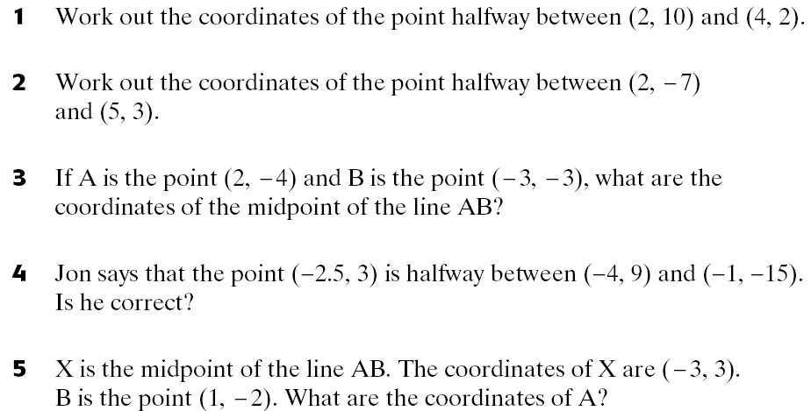
Straight Lines
Now try these:
(3,6)
(3½,⁻2)
(⁻½,⁻3½)
difference in x = 3
difference in y = 24
½ difference in x = 1½
½ difference in y = 12
(⁻4+1½,⁻15+12)
=(⁻2½,⁻3)
No
difference in x = 4
difference in y = 5
double difference in x = 8
double difference in y = 10
(1-8,⁻2+10)
(⁻7,8)

Slide 8
Straight Lines
Question 5 Explained
y
difference in x = 4
difference in y = 5
10
x
A
(⁻7,8)
9
Because X is the mid-point
A is double the horizontal
and vertical distances.
8
7
6
X
5
y
x
4
double difference in x = 8
double difference in y = 10
3
½y
2
1
x
-10
-9
-8
-7
-6
-5
-4
-3
-2
-1
0
1
2
3
4
5
6
7
8
9
10
-1
x
x
½x
-2
B
-3
-4
-5
-6
-7
-8
-9
-10

